Slide 1
Hydrological Information System
Module - Automatic Weather Station and Automatic Rain Gauge
Anish
….. Hydro-Informatics Expert
The World Bank

Slide 2
Examples that refer to products are intended for illustrative purposes only, and do not imply an endorsement or recommendation of any particular product

Slide 3
Introduction
What is Automatic Weather Station?
What Data does it provide?
How and where that data is useful?
  Calculation of Evaporation
    Loss from Lakes and Reservoirs
  Estimation of Evapotranspiration
    Crop water requirement estimation
  Weather forecasting
    Temperature, pressure humidity variations

Slide 4
Module Contents
Network Design
Site Selection
Selection of Instruments
Data logger
Integration of Other Sensors in AWS
Telemetry
Installation
Sensor Specification
Costs
Operation and Maintenance

Slide 5
Physical Location
Security
Telemetry Window
Power Options
Accessibility
Ownership of Land
Site Selection

Slide 6
Site Security
Preferably at Manned positions
Research Stations of Agricultural Universities
Dam and Barrage Sites
Govt. Rest Houses, Circuit Houses
District / Block Headquarters
Private Property
Police Stations ?
Site Selection

Slide 7
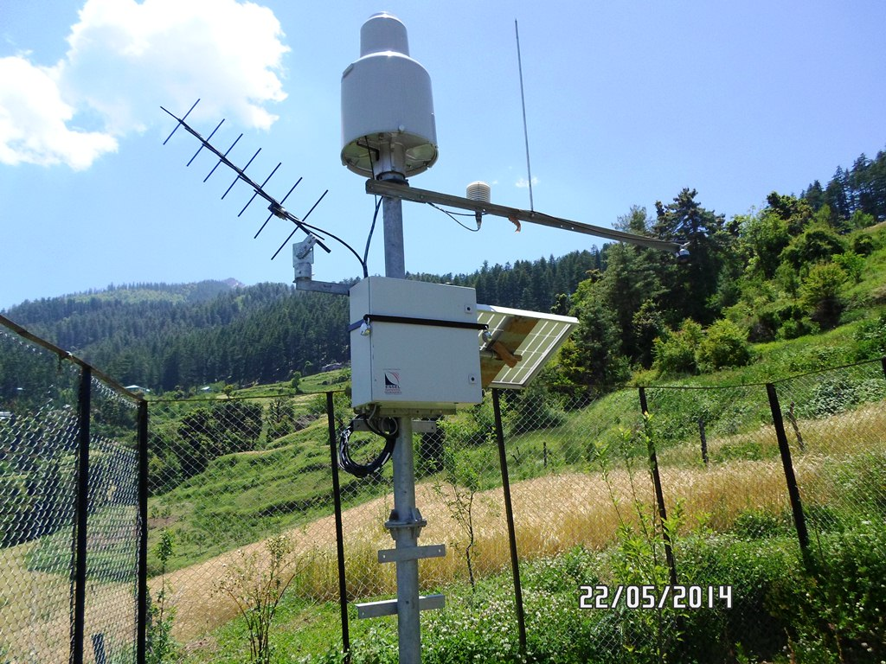
Examples of Good Sites for AWS
Site Selection
AWS in a Private Property at Madana

Slide 8
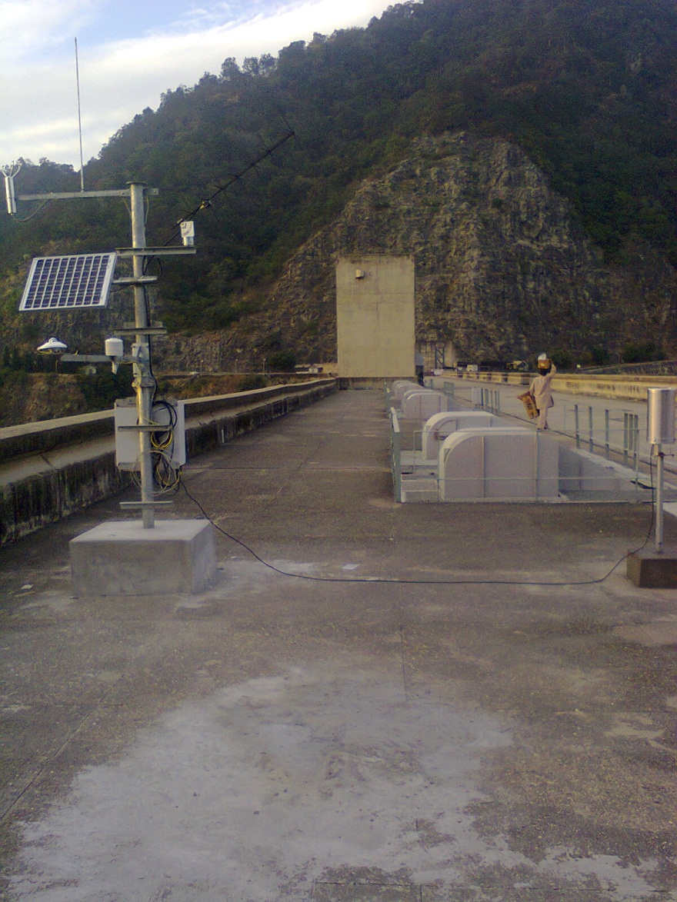
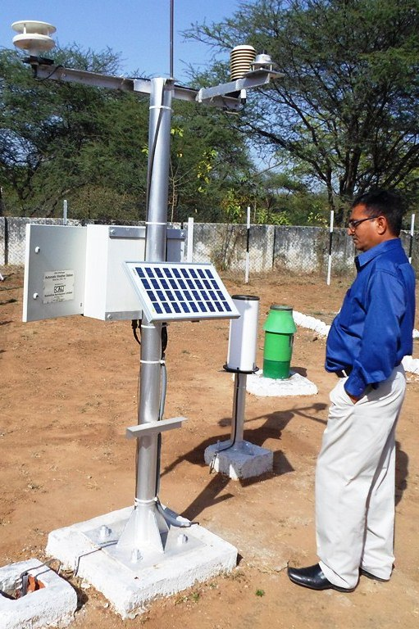
Examples of Good Sites for AWS
Site Selection
AWS on top of Bhakra Dam
AWS in WRD Premises, Gandhinagar

Slide 9
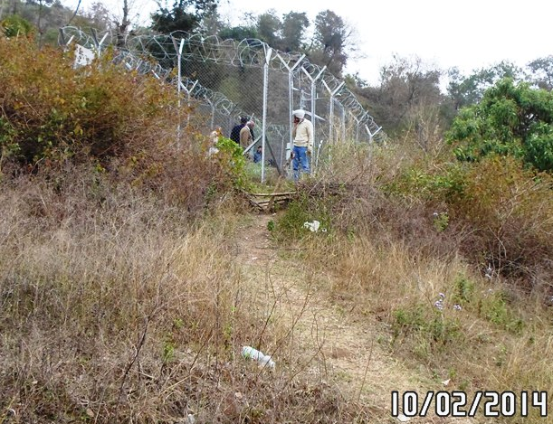
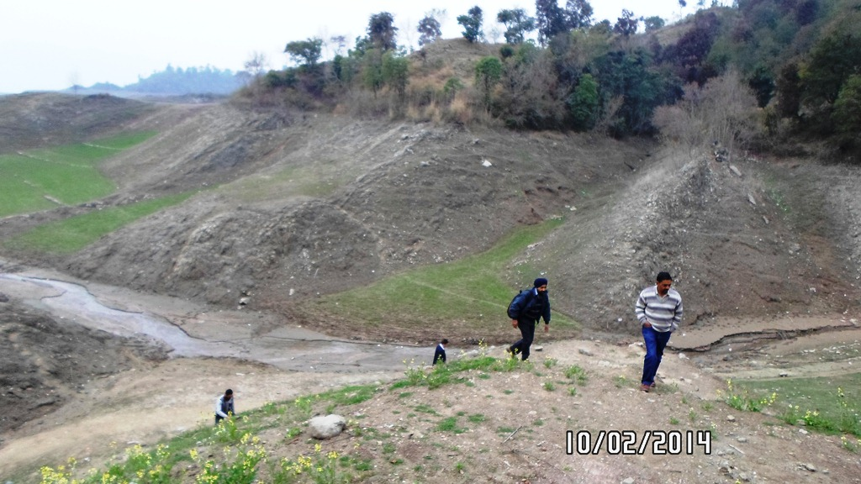
Examples of Good Sites for AWS
Site Selection
Site at Brahmani, need to reach by boat, nearest road kilometers away

Slide 10
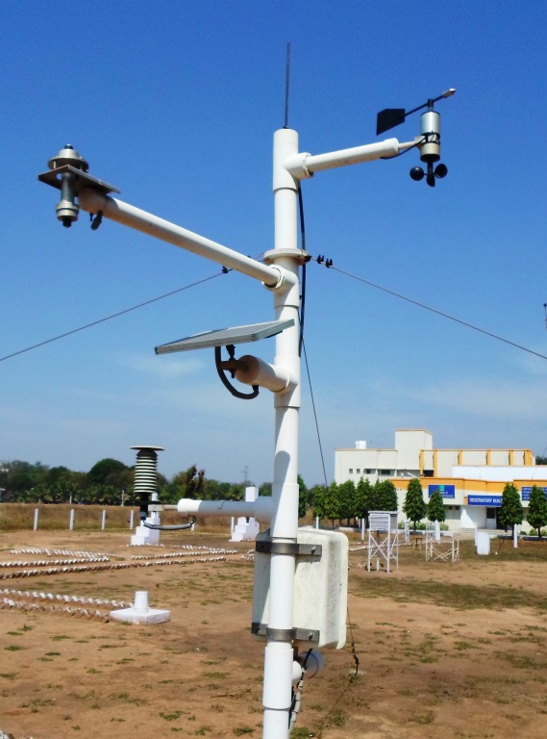
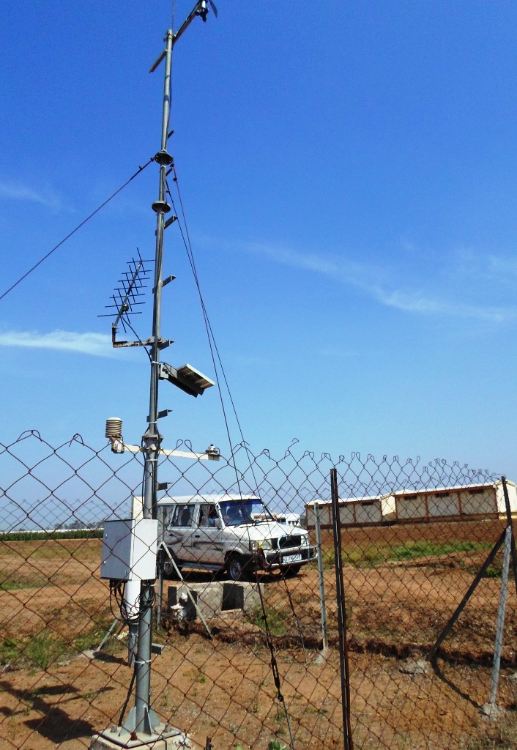
Examples of Good Sites for AWS
Site Selection
AWS in Anand Agricultural University Campus, Anand
ISRO AWS inside Agricultural research Station in Sampli, Gujarat

Slide 11
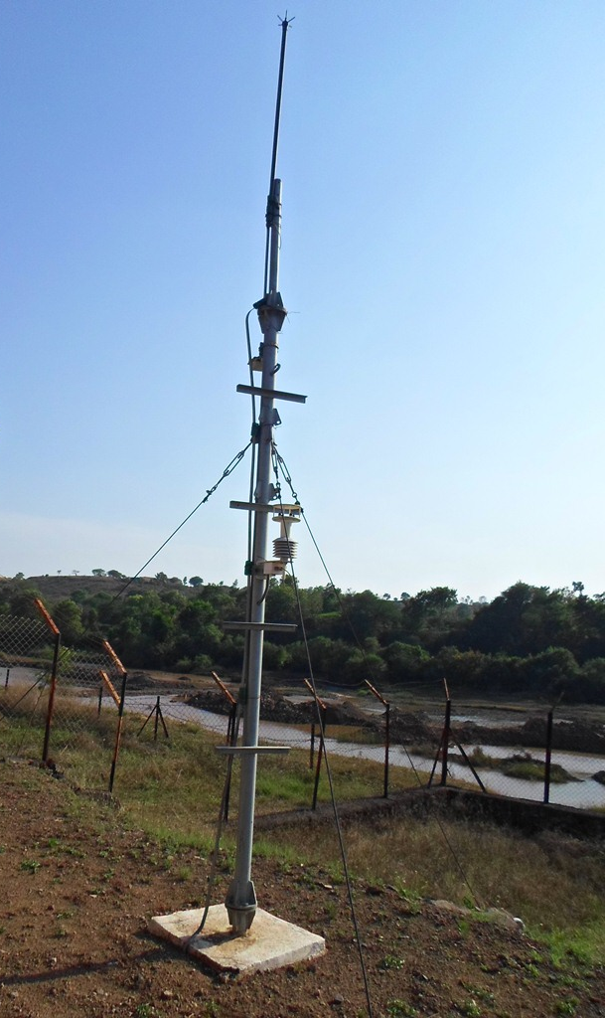
Examples of Good Sites for AWS
Site Selection
AWS at WRD premises near Pune, Maharashtra

Slide 12
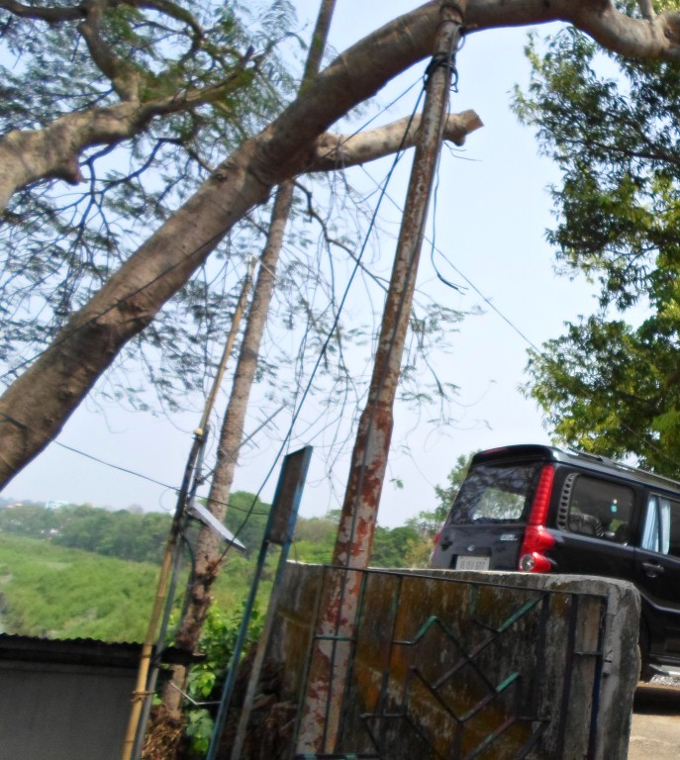
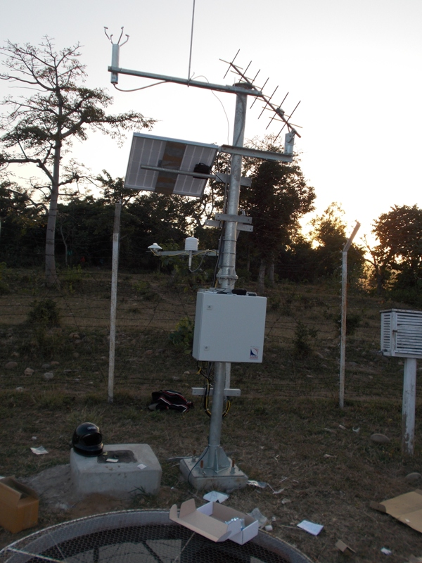
Telemetry Window
For Satellite Telemetry, Direct Line of Site
Good Mobile Coverage for GSM based
Site Selection
Antennae LoS Obstructed by trees
No Problem Here!

Slide 13
Power Options
Is Reliable AC Power available?
  2-3 Hours a day enough to Recharge battery
For Solar, is enough Sunlight Available?
What should be size of Solar Panels
What should be size of Battery?
  100 AH Battery with 40 Watt Solar Panel recommended for North India
  64 AH with 24-30 Watt Panels for Tropical Regions (Below 23 degree latitude)
  In Gujarat, 26 AH Battery with 10 W Panels also used
Internal Battery not an option for AWS
Site Selection

Slide 14
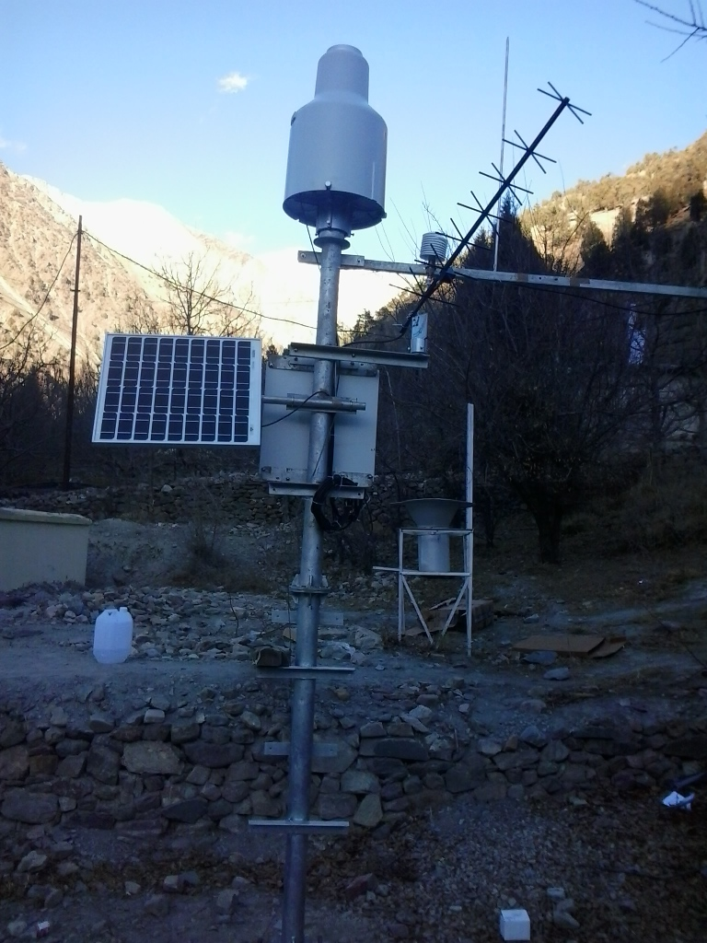
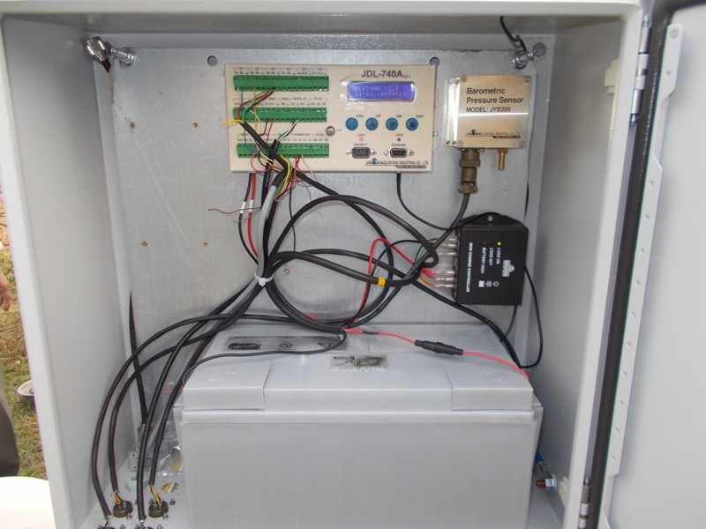
Power Options – Himachal Region
Site Selection
100 AH Battery
40 Watt Solar Panel

Slide 15
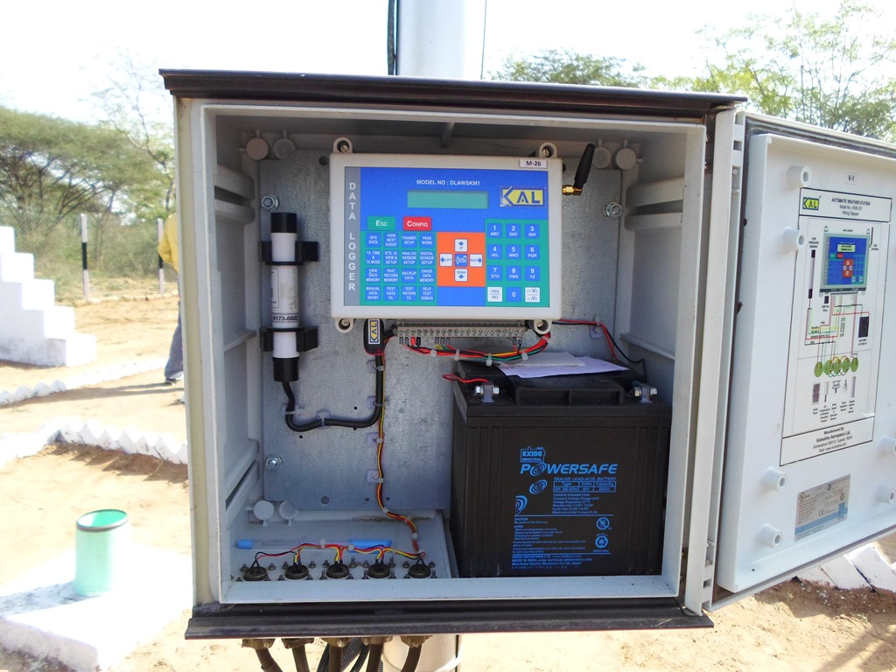
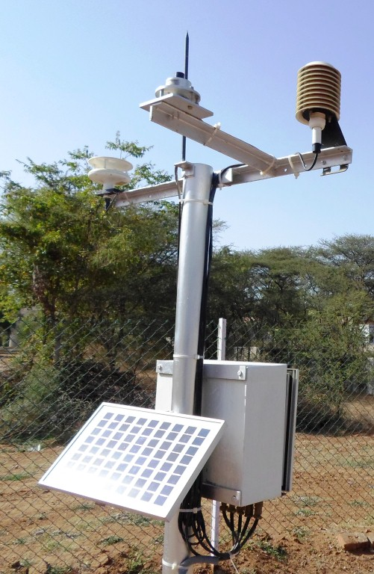
Power Options – Gujarat
Site Selection
26 AH Battery
With 10 Watt Solar Panels

Slide 16
Selection of Sensor
Automatic Rain Gauge
Solar Radiation
Wind Velocity and Direction
Temperature
Humidity
Atmospheric Pressure
Evaporation
Selection of Instruments

Slide 17
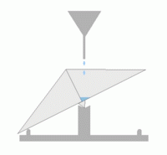
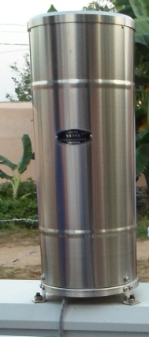
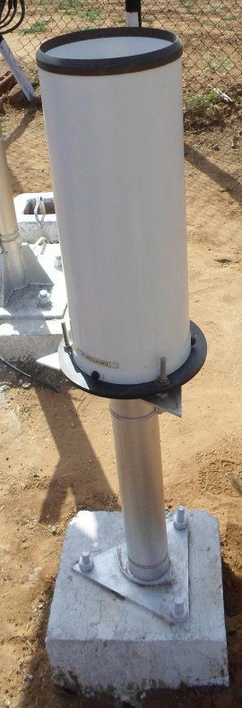
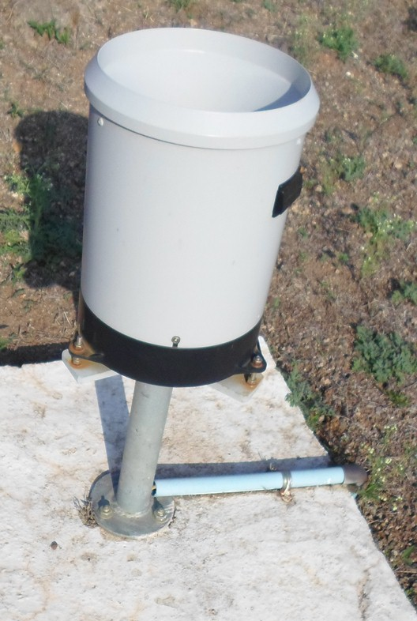
Automatic Rain gauge
Tipping Bucket Rain gauge
Dual Reed Switch to count Bucket tips
Available with or without Syphon
Selection of Instruments
Odisha
Gujarat
Maharashtra

Slide 18
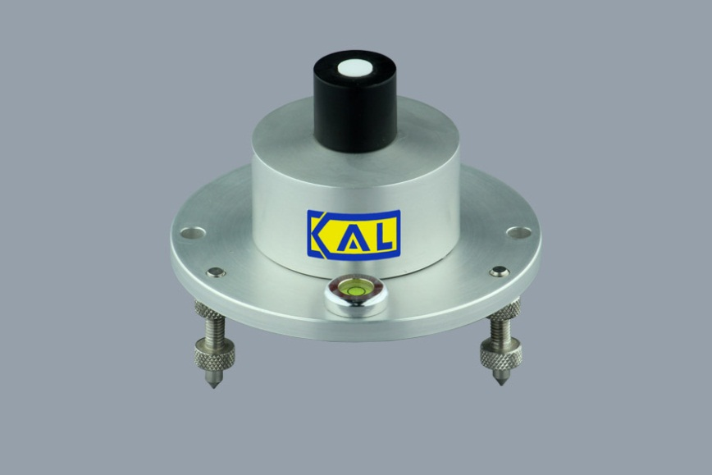
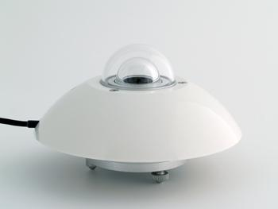
Solar Radiation
Silicon Photodiode based sensors
  Calibration depends on Solar Azimuth angle
  Cheaper option
Thermopile based Sensors
  Class 1 Equipment
  Expensive but more reliable option
Selection of Instruments
Silicon Photodiode Sensor
Thermopile based Pyrometer

Slide 19
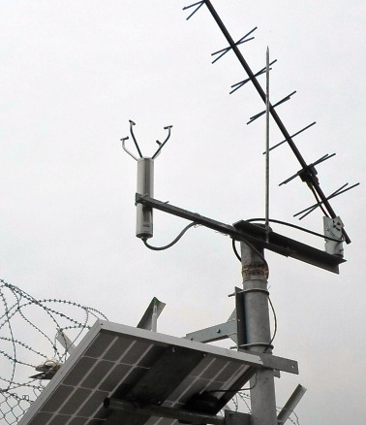
Wind Velocity and Direction
Ultrasonic Sensor with no moving parts
  Maintenance free but expensive option
  One sensor provides direction and velocity
Selection of Instruments
Site in Gandhinagar, Gujarat
Site in Brahmani, Himachal Pradesh

Slide 20
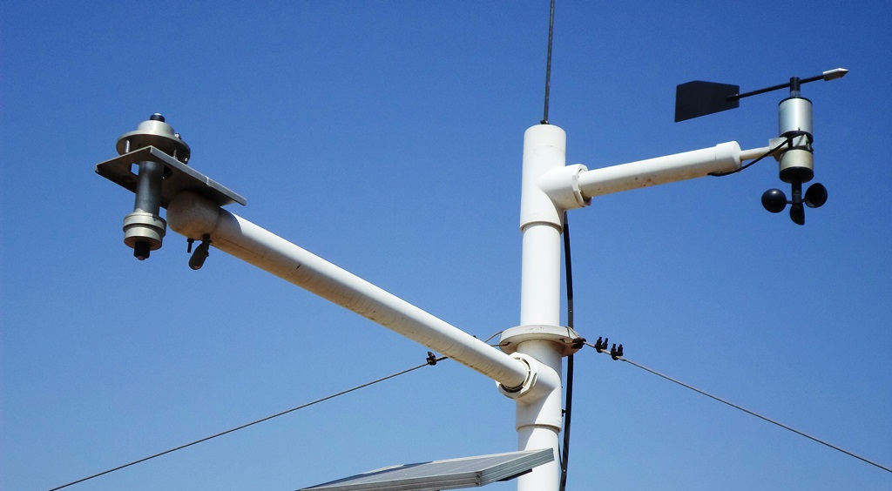
Wind Velocity and Direction
Wind vane and Cup Anemometer
  Cheaper option
  Moving Parts, Needs frequent maintenance
Selection of Instruments
Site in Anand, Gujarat

Slide 21
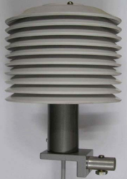
Temperature and Humidity Sensor
Resistance based Temperature Sensor
Capacitive Humidity Sensor
Often Temperature and Humidity sensors come as single hardware
Selection of Instruments

Slide 22
Atmospheric Pressure
Sensor based on MEMS
Indoor unit
Selection of Instruments
Site in Bhubaneswar, Odisha
Site in Sampli, Gujarat
Site in Harsar, Himachal Pradesh

Slide 23
General Features
Central and Most Important part of AWS
Functions
  Supplies Power to Sensors,
  Reads and record data
  Pass on data to telemetry unit for transmission
  Highly configurable based on requirements
  Some Models available with inbuilt GSM transmitter
  Some Data loggers are integral part of Sensor
Data Logger

Slide 24
Data Logger Specifications
Sensor Interface
  8 analogue channels
  8 digital input/output channels, 2 input for rain gauge impulses, 6 bidirectional
  Minimum 1 serial port for digital input SDI-12
Input/output interfaces
  One for the INSAT radio
  One for the addition of GSM radio
  One Serial Port (RS232) for communication with Laptop or programming
  USB Stick option for Data transfer
Data Logger

Slide 25
Data Logger Specifications
Flash memory minimum 32 mb
Non-volatile flash memory
A/D resolution ≥16 bit
Individual recording intervals for each sensor/parameter
Multi-tasking operating system - must log data and transmit at same time
Digital Display for viewing current data and setting values
Power supply 12V DC, low current drain (quiescent ≤10.0mA)
Monitoring of battery voltage level
internal battery backup for clock
Data Logger

Slide 26
Data Logger Specifications
Software
  Windows software for system configuration / communication
  English language version
  All required licenses included
  Different user levels, system of user rights / passwords, access restricted to authorized personnel
Data Logger

Slide 27
Data logger - Examples
Data Logger
Nanjing Datalogger with Customized display for Water level and Rain; Bhubaneswar

Slide 28
Data logger - Examples
Data Logger
Komoline Data logger with inbuilt GSM Transmitter, Ahmedabad

Slide 29
Data logger - Examples
Data Logger
Installed in 2001, Still working Perfect!
Data logger as part of Shaft Encoder with internal battery, Gandhi Nagar, Gujarat

Slide 30
Data logger - Examples
Data Logger
Jinyang Data logger showing input, output and communication ports, Kapla, Himachal Pradesh

Slide 31
Data logger - Examples
Sutron Data Logger with in built Satellite Transmitter
Sutron Data Logger with inbuilt Satellite Transmitter, Display and Keypad
Data Logger

Slide 32
Integration of AWS with other Sensors
Data Logger is the major deciding factor for feasibility of integration
With Specifications of Data Logger mentioned above, it is possible to integrate any type of station and large number of sensors
Future Integration needs should be considered for deciding Data logger Specifications
  If no need for integration – Low end Data logger
  If chance of adding more sensors in future – High end Data logger (Expansive option)
Integration

Slide 33
Integration Examples
AWS Installed at Nangal Dam (Punjab) along with
  Reservoir Water Level
  Outflow Canal Water Level
  Connectivity via wires for Dam level and Canal A
  Wireless connectivity with Canal B
Integration

Slide 34
Integration Examples
Integration
Integration at Bhuntar on Beas River with
  River Gauge site using bubbler
  River Discharge site using ADCP

Slide 35
Integration Examples
Integration
Integration at Anand, Gujarat with
  Soil Moisture Probe
  Leaf Wetness Sensor
  Groundwater Level Sensor

Slide 36
Introduction
The telemetry Device transmits data to central server location
Can provide One-Way or Two Way Communication
  One Way – Push method
  Two Way – Push and Pull Method
The communication medium can be:
  GSM Towers
  Satellites
    INSAT Radio Transmitter
    VSAT
Telemetry

Slide 37
GSM Based Telemetry
The Telemetry device has SIM card
  Can transmit via SMS or GPRS internet
Telemetry Device can be:
Telemetry
Integral part of Data logger
Separate Device

Slide 38
Satellite Based Telemetry
Telemetry
VSAT based two way communication
INSAT based one way communication
Finer Details of Telemetry are covered in Telemetry Module

Slide 39
Masts
Masts should be Sturdy, rust proof
Installed on good concrete foundation
Should not vibrate with wind
Installation

Slide 40
Solar Panels
Installation
What is wrong here?
Solar Panel in Shadow of Trees

Slide 41
Solar Panels
Installation
Chitkul, Himachal Pradesh
Anand, Gujarat

Slide 42
Solar Panel
Almost Vertical in Himachal
Almost Horizontal in Gujarat
Installation
What should be Right Direction?
What is major difference in solar Panel Installation?

Slide 43
Solar Panel - Direction
In Northern Hemisphere, Solar Panel always faces South
This maximizes sunlight, specially during winter
The tilt angle w.r.t. ground should be equal to Latitude of Location
  Horizontal (0 degree tilt) at Equator
  30-35 degree for northern states
Installation

Slide 44
Connections and Wires
Installation
Label the Connection wires if feasible

Slide 45
General Specifications
Ambient Site Condition
  Humidity Range – 5 to 100%
  Temperature Range –
    -20 to +60 Degree for plain areas
    -40 to +40 Degree for Himalayan Regions
  Altitude –
    300 to 3000 meter for Himalayan Regions
    0 to 1000 meter for other regions
Enclosures – Outdoor Antirust and dust-free
Protection - NEMA 4 or IP65
Specifications

Slide 46
Enclosures
Specifications

Slide 47
General Specifications
Radiation shield of double wall
All connections and wires should be concealed
Lightning protection – All equipment to be surge protected
Fencing – Chain link fence with barbed wire
All Accessories, tools, fixtures required for installation and operation
Specifications

Slide 48
General Specifications
User Manuals – Complete manuals in English
Operation and Maintenance manuals
  Complete Manuals including Wiring Diagrams
  System Block Diagrams
Power Consumption
  Low Power consumption with standby option
GPS for time synchronization
Power Supply – Enough to last for 6 days of operation without charging
Specifications

Slide 49
Automatic Rain gauge
Sensor Type Tipping Bucket with reed switch
Range 0-500 mm/h
Bucket Capacity 0.2, 0.5 or 1.0 mm
  The size depends on Peak Rainfall Intensity
Specifications
0.2 mm
0.5 mm
1.0 mm

Slide 50
Automatic Rain gauge
Accuracy (Intensity) 2 % or better
Output Interface As specified in Data logger
Rain collector Material
  Corrosion Resistance Metal (Stainless steel/ Aluminum) or UV Stabilized Fiber Plastic
Enclosure IP65
All openings of the rain gauge shall be covered with a screen to protect against insects
Syphon system to eliminate over accumulation or under accumulation of precipitation
collecting funnel diameter 200mm
Ability to service tipping buckets without involving the re-levelling of the gauge
Specifications

Slide 51
Automatic Rain gauge
Specifications
Leveling Mechanism
Raingauge with UV Stabilized Fibre Plastic Body
Raingauge with Stainless Steel Body

Slide 52
Solar Radiation Sensor Option 1
Sensor Type Silicon Photovoltaic
Spectral Range 400-3000 nm
Range 0-2000 W/m²
Resolution 1 W/m²
Accuracy
  5% Including Temperature Compensation
Response time 10 Sec or better
Output Interface
  As specified in Data logger
Specifications

Slide 53
Solar Radiation Sensor Option 2
Sensor Type
  Pyranometer (CMP 11 or better)
ISO Classification ISO Class I
Spectral Range 300-3000 nm
Range 0-2000 W/m²
Resolution 1 W/m²
Accuracy
  3% Including Temp Compensation
Response time 10 Sec or better
Output Interface
  As specified in Data logger
Specifications

Slide 54
Wind Velocity and Direction Option - 1
Sensor Type
  Ultrasonic sensor (No moving Parts)
Range
  65m/s for speed
  0–360 degrees for direction
Resolution
  0.01 m/s for speed
  0.1 degree for direction
Accuracy
  0.2m/s or 3% for speed
  +/- 2 degrees for direction
Output Interface
  As specified in Data logger
Specifications

Slide 55
Wind Velocity and Direction Option - 2
Sensor Type
  Non Contact encoders with cup anemometer and wind vane
Range
  0.3 to 65m/s for speed
  0–360 degrees for direction
Resolution
  0.01 m/s for speed
  0.1 degree for direction
Accuracy
  0. 4 m/s for speed
  +/- 5 degrees for direction
Output Interface
  As specified in Data logger
Specifications

Slide 56
Temperature Sensor
Sensor Type
  Resistance type Temperature Sensor
Range
  -40 to60 Degree C
Resolution
  ± 0.1°C
Accuracy
  0.3°C or better
Output Interface
  As specified in Data logger
Specifications

Slide 57
Humidity Sensor
Sensor Type
  Capacitive/ Solid State Humidity Sensor
Range
  5 to 100 %
Resolution
  0.5%
Accuracy
  ±3% or better
Output Interface
  As specified in Data logger
Specifications

Slide 58
Atmospheric Pressure Sensor
Sensor Type
  Temperature Compensated
Range
  800-1200 hPa
Resolution
  ±0.01hPa
Accuracy
  ±0.5 hPa
Output Interface
  As specified in Data logger
Specifications

Slide 59
Thank You

